Slide 1
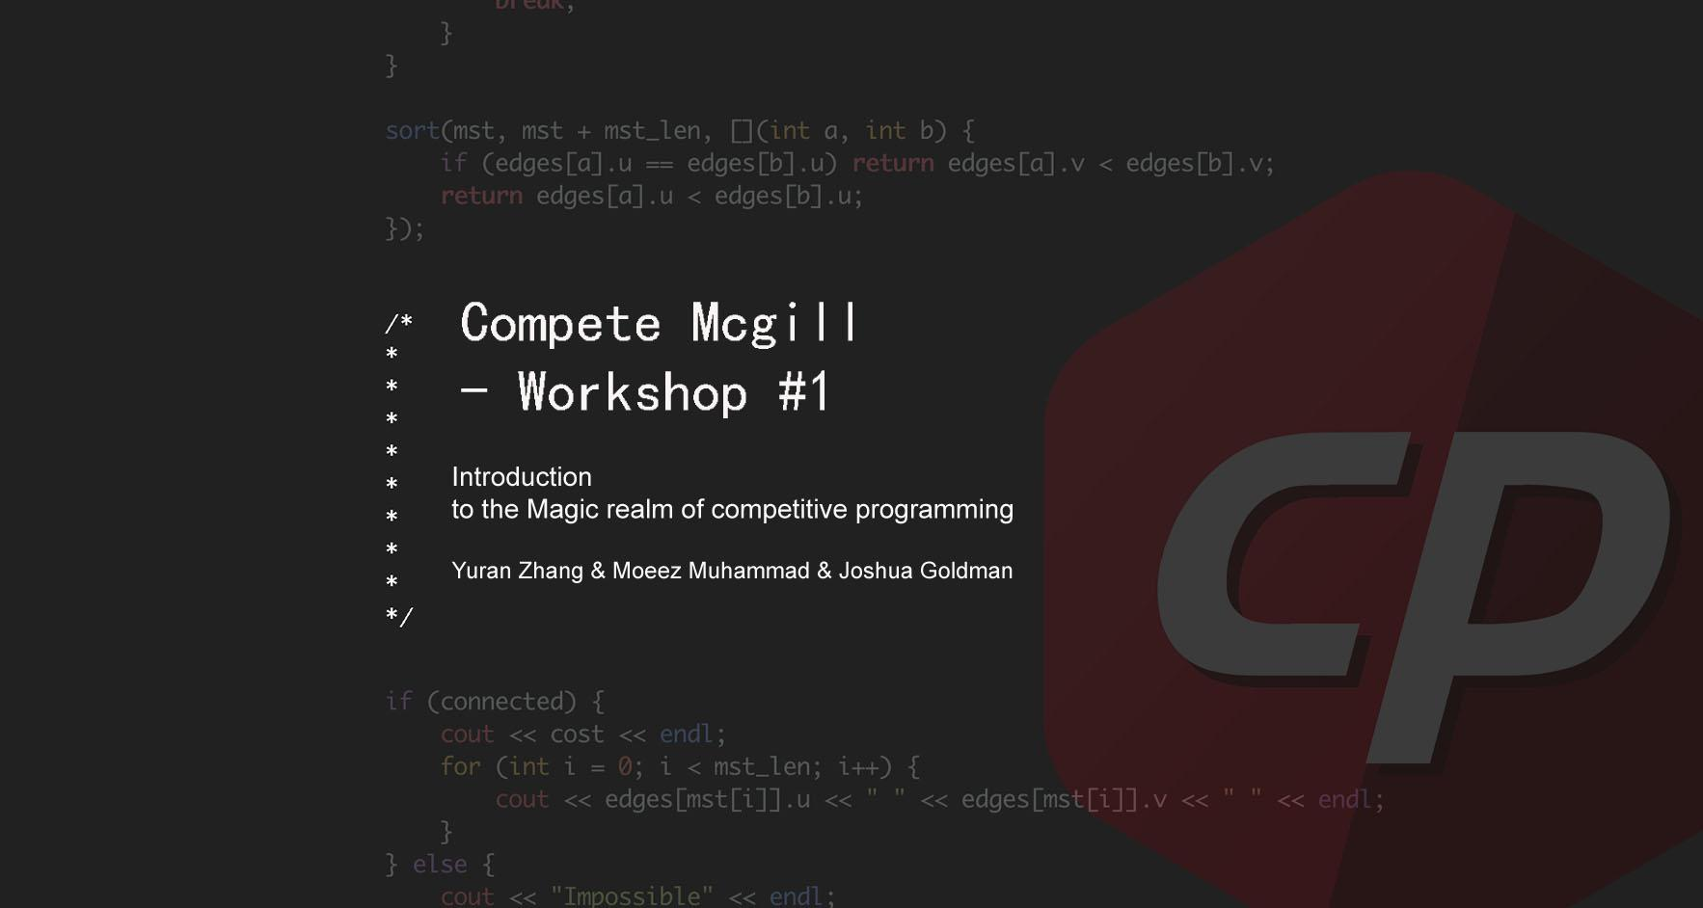

Slide 2
Introduction - General Idea of CP
A mental sport which enables one to code a problem given specific constraints (program’s time & memory limit) under a competitive(speed, correctness) setting. (length of code doesn’t matter, but recommended keep code short possible - to solve problem in shortest time)

Slide 3
Outline
Part 1 - Introduction
Part 2 - General Tips for CP
Part 3 - Practice - Online Judges
Part 4 - Problem session

Slide 4
Prereqs?
Disclaimer: competitive programming is not an easy journey - need to invest big chunks of time and energy to become good at it.
But we’re here ‘cause we are competitive, we want to break our limits, to become better programmer.
Should be familiar with at least ONE programming language(Python, Java, C++, C)
Have solid knowledge of basic Algorithms and DS (from 250 or equivalent) as well as basic complexity analysis techniques.
Preferably have completed Comp 251/252, but not necessary as we’ll start from the basics and will revisit many topics. (but in C++)

Slide 5
Benefits of CP
For interviews! Similar but usually easier problem, training for CP will help you nail most interviews from top tech companies with ease!
Sharpen one’s mind, develop critical thinking & problem solving ability, be able to code efficiently -> become a better programmer!
Team work! Most CP contests are done in teams, collaboration is critical in succeeding.
High achievements from contests are valuable assets to put on CV - recognized by many big tech companies.

Slide 6



What kind contest are we competing in?
Many contests available: Google code Jam, Facebook Hacker Cup, IOI, TopCoder open round, etc…
But we’ll be focusing on ICPC(International Collegiate Programming Contest) !!!

Slide 7
ICPC Structure
NAQ(Qualifier): Sept.30, this Saturday, in person at Trottier …
ICPC Regional(NENA): select top (one)team from representing Mcgill to participate in NAC) - Oct.28
NAC (Championship) -TBD(~every May)
ICPC World Final

Slide 8
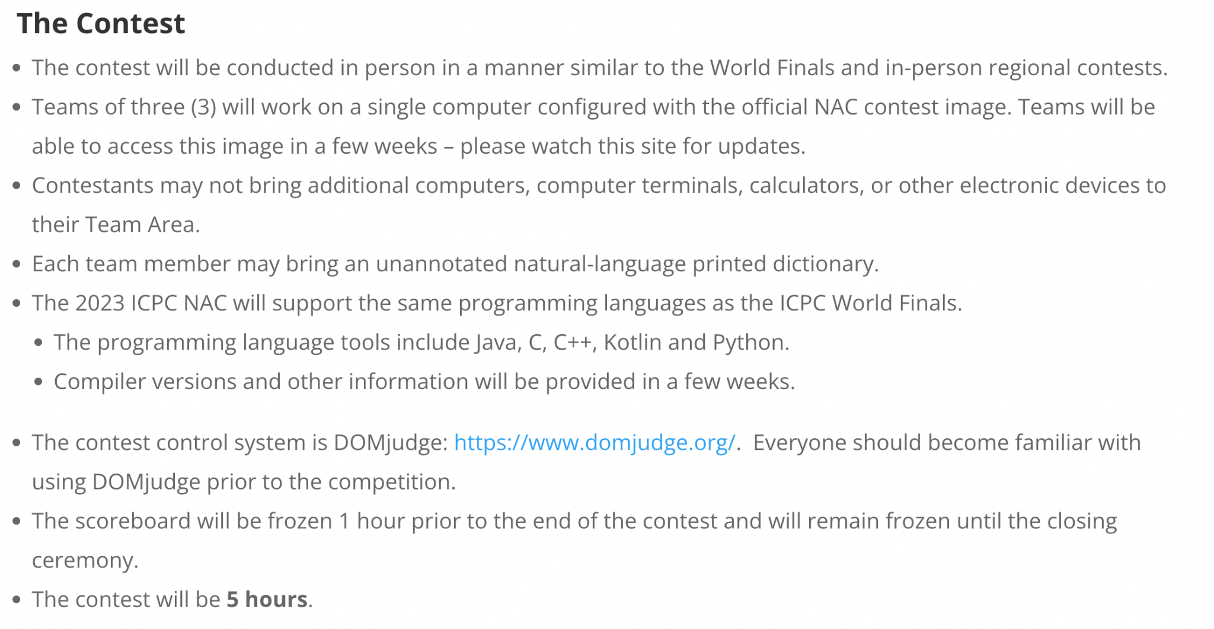
Contest Format
In teams of 3 (for NAQ not mandatory but preferred), but only 1 laptop allowed (team work strategy!)
5 hrs to compete
~15 problems(2~3 trival, 1~2 easy, 4~6 medium, ~6 hard), problems will not be ranking in the order of difficulty! So it’s your task to distinguish the easy ones from harder ones (very important skill!)

Slide 9
Contest Ranking
Teams are ranked according to the most problems solved. Teams who solve the same number of problems are ranked first by least total time(penalty) and, if need be, by the earliest time of the last accepted submission.

Slide 10
Language Choice
1. C++(most preferred): super fast execution time, short neat code, rich library of different algorithms(STL containers), easy to use/understand(excluding OOP), lots of resources on c++ tips. but can be annoying to debug (when working with array memory), meaningless errorMessage(I hate segmentation fault…)
Python(also loved by many, recommended): shortest to code(time is gold), rich library, downside is runs much slower than c++(but slightly faster than Java on kattis) — more to be added as I’m not a python user

Slide 11
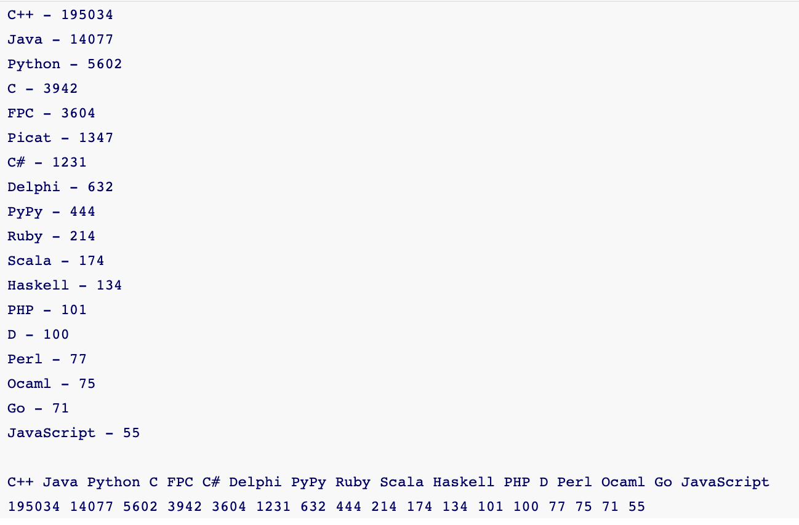
Language Choice(cont’d)
Java: useful classes(e.g BigInteger) that’s not offered in other languages, much clearer errorMessage on exceptions. Downsides: longest to code (fast I/O can take up to 50 lines…so better have the code handy), runs kinda slow on most online judges
Language usage statistics in contests: https://codeforces.com/blog/entry/20525

Slide 12
Welcome to the Magic Realm of Competitive Programming!!

Slide 13
Problem Solving Tips
Usually in 3 steps:
Problem dissection - Understanding the problem
Problem Categorization + Input Analysis
Algorithm Design + Implementation - Covered in future workshops

Slide 14
Problem Structure
Background story/problem description. Most problem descriptions are interesting. However, the easier problems are usually written to deceive contestants and made to appear difficult, for example by adding ‘extra’ information’ to create a diversion. Contestants should be able to filter out these unimportant details and focus on the essential ones.
Input and Output (I/O) description. In this section, you will be given details on how the input is formatted and on how you should format your output as well as the input constraints.
Sample Input and Sample Output. Problem authors usually only provide trivial test cases to contestants to better understand the problem
*Caution: Make sure to fully understand the sample before start brainstorm for a solution! (sketches / small instances of the problem might be useful)

Slide 15
Input Complexity Analysis(VERY IMPORTANT!!!)
Modern computer can process ~100M in 1 sec
After brainstorming for some time, you come up with a seemingly feasible solution. Before try to implement it, how will you know it’s fast enough given the time constraint?
Perform Algorithm analysis!
Analyze the complexity of algorithm you come up with (apply techniques learned in Comp 250, 251/252, 360!) - will also cover some in future workshops
Check if it’s fast enough on problem’s input size (next slide)

Slide 16
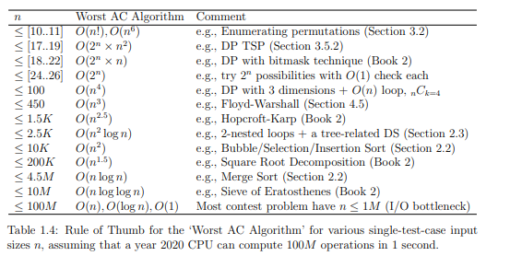
Source: Competitive Programmer Handbook 4 (Steven & Felix)

Slide 17
Complexity Analysis (cont’d)
Input size can also give very informative hints on the type of algorithm you can use to solve the problem.
Caution! Refrain from coding until you’re sure your algorithm is both correct & fast enough! Such careful analysis is the most important thing for programming contests!!!

Slide 18
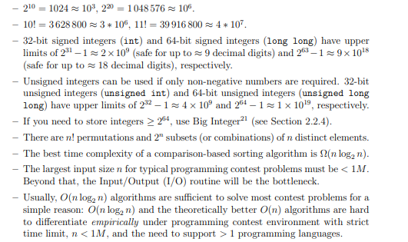
Common Bounds

Slide 19
Design & Implementation
Depending on the context, wisely choose the programming language to use - covered in future workshops.
Will mostly be using C++ & Python

Slide 20
The art of debugging
It’s often the case that your algorithms seems correct and passes all sample test cases but fails on some hidden test case.
Problem author often comes up with very tricky test (edge) cases and make them as hidden ones, so make sure your code works in possible cases you can imagine!
See kattis - Moscowdream

Slide 21
The art of debugging(cont’d)
What can possibly be such edge cases?
Example:
Simple edge case: if constraint: 1<= n <= 1000000 following contains n lines with integer 0 <= x <= 1000000, does your code work for n=1 and x=0?
More complex: what if n=1000000 and x is also large? Can the result possibly overflow (32-bit int = 2^32)? Do I need to use 64-bit int (long long) to store the result instead?
*the result above will overflow if using 32-bit int! (assuming need to take sum of all numbers and n=1000000, each x = 1000000)

Slide 22
Debugging(cont’d)
Again, designing good tricky test cases on your own is not an easy task but is essential for every competitive programmer! Developing the intuition for it requires lots of practice!

Slide 23
Team Work Strategy
Unlike previous tests/contests you’ve done previously, programming contests are ALWAYS done in teams, thus an effective strategy is CRUCIAL in succeeding in the contest.
Recommendation: (for easier ones that are doable individually)one person typing solution to a problem on laptop while two other write down idea/solution on paper. (for harder ones) all 3 people work on the same problem, brainstorm for inspirations.
Feel free to come up with other strategies you think is better and use them in contests!

Slide 24
What are online judges?
An online judge is an online system to test programs in programming contests. They are the best place to practice real contest problems from the past. The system can compile and execute your code, and test your code with pre-constructed data sets.

Slide 25
Some Common Online Judge Platform
*UVa: https://onlinejudge.org/
*Kattis: https://open.kattis.com/ - Where NAQ will be held
*CodeForces: https://codeforces.com/ - Highly recommend
TopCoder: https://www.topcoder.com/
Atcoder:https://atcoder.jp/
DMOJ: https://dmoj.ca/ - Some ICPC contests are held here
USACO: https://train.usaco.org/ - Mostly for IOIs, but problems are good

Slide 26
Kattis - How to submit (illustrated using examples)
Reference: https://open.kattis.com/help/submit

Slide 27
Kattis - Judgements
References: https://open.kattis.com/help/judgements

Slide 28
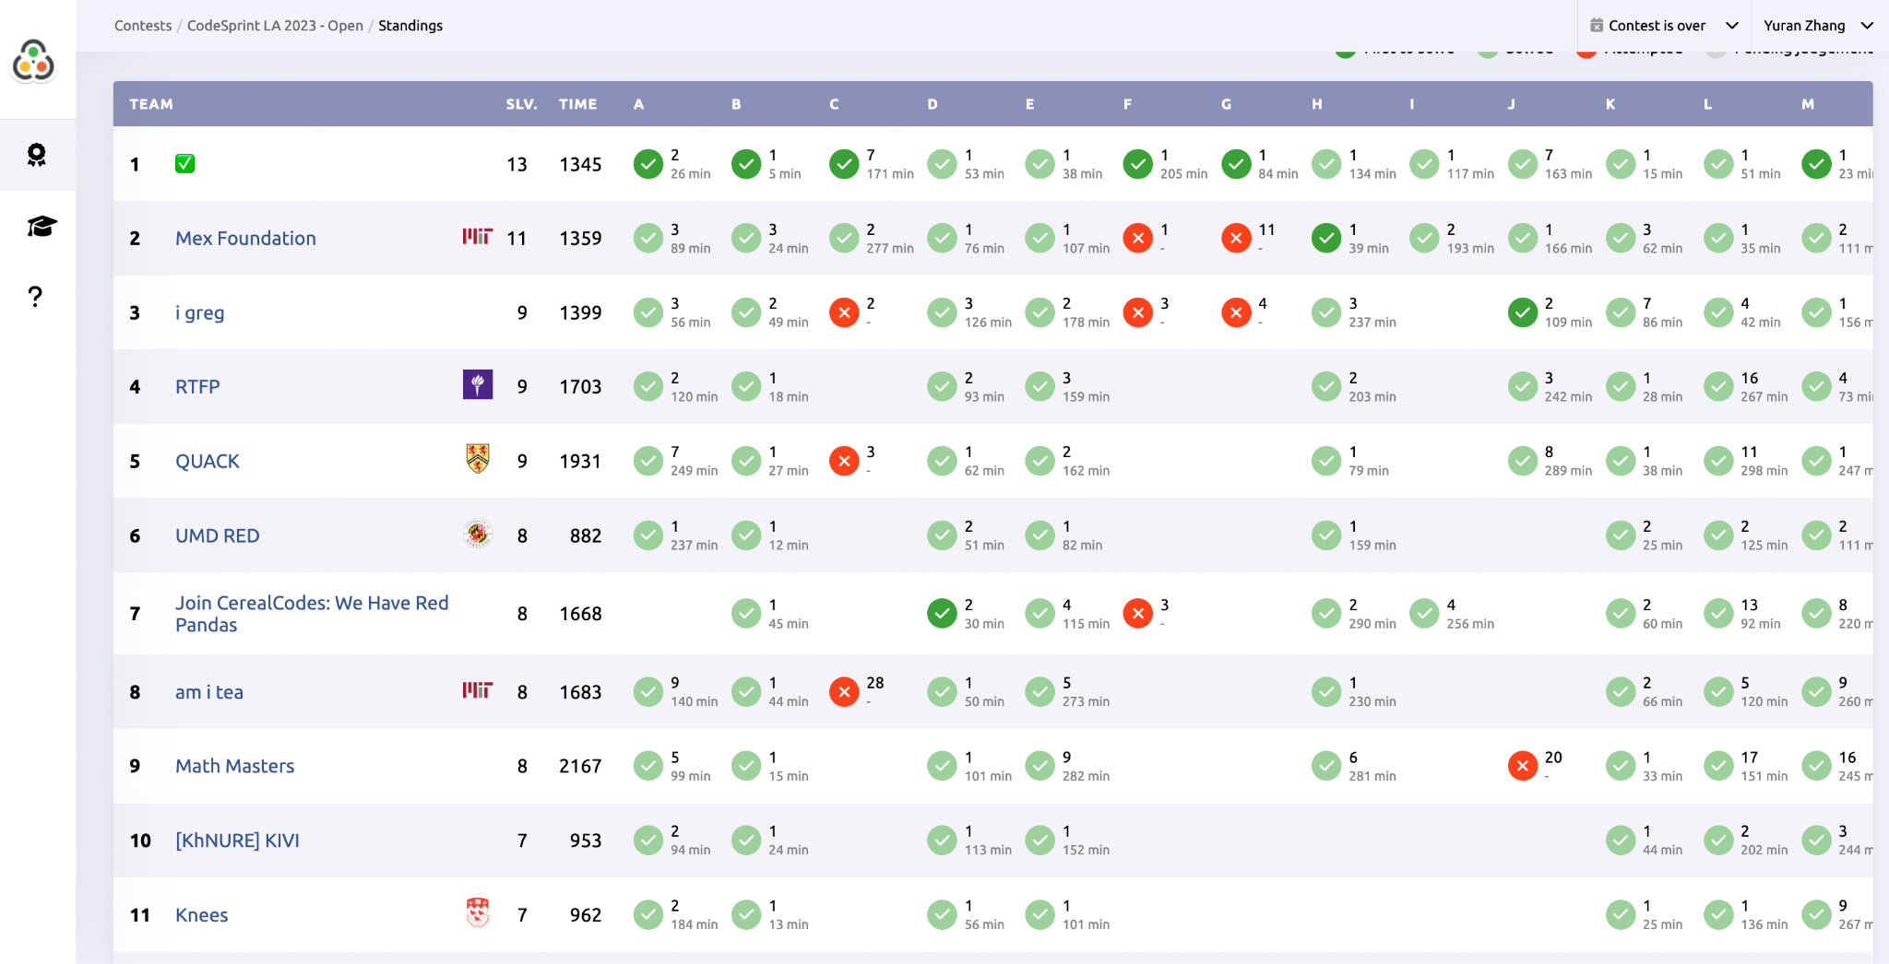
Kattis - What does an Actual ICPC scoreboard look like?

Slide 29
Kattis - How should Input/Output be done?
Equivalent to taking input from STDIN and print to STDOUT (same way as you would do for command line)
C++: scanf(“%d”, &n), printf(“%d”, n), I/O stream cin >> and cout <<
Java: Scanner.nextLine() + split()/StringTokenizer class, nextInt(), nextChar(), etc, preferably use fast I/O BufferedReader and PrintWriter()
Python: input() + split()
More detail in next slides…

Slide 30
I/O(cont’d)
Different Types of I/O:
Single test case with single line/multiple(n) lines
multiple test cases with/without case # + special terminating signal(0 or EOF)
variable # of inputs
Explained using kattis examples

Slide 31

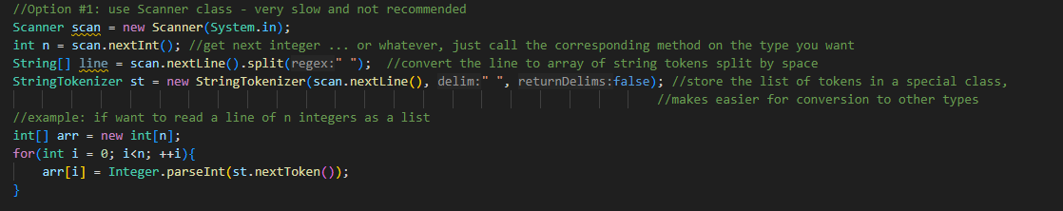
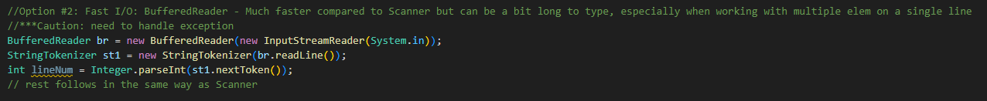

I/O in Java

Slide 32
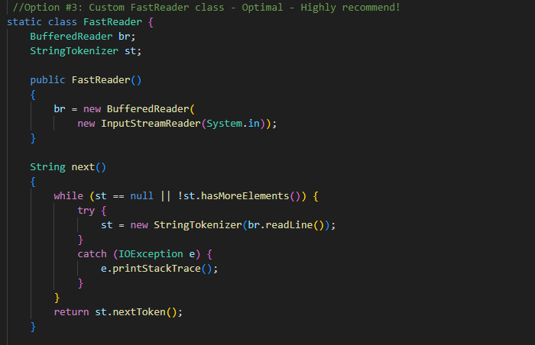
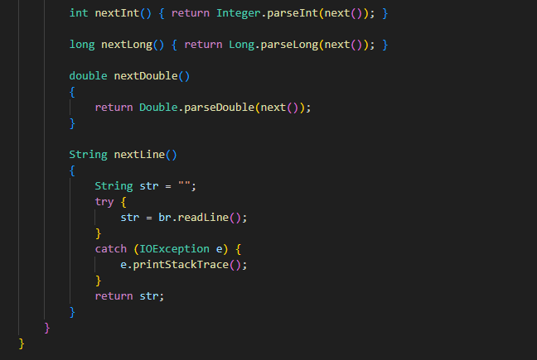
I/O in Java

Slide 33
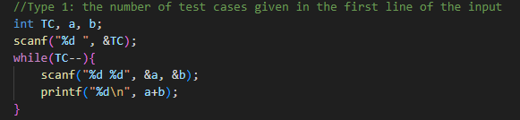
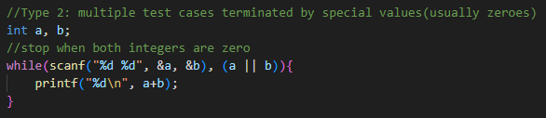
I/O(C++)

Slide 34
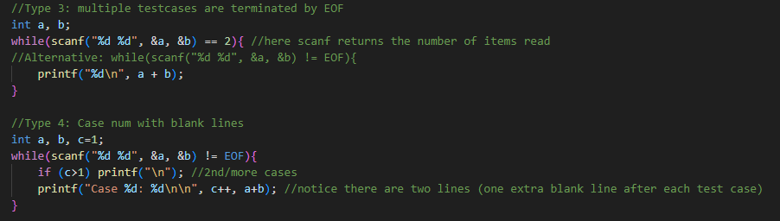
I/O(C++)

Slide 35
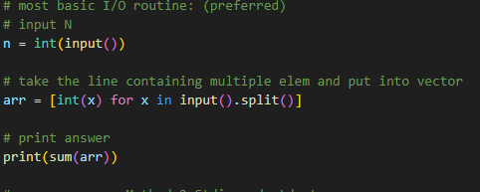
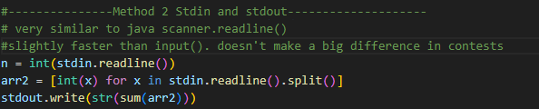
I/O in Python

Slide 36
Now, let’s try to submit our first Hello world Program!
https://open.kattis.com/problems/hello

Slide 37
Fast I/O
C++: https://www.geeksforgeeks.org/fast-io-for-competitive-programming/
Java: https://www.geeksforgeeks.org/which-java-libraries-are-useful-for-competitive-programming/?ref=rp
Python: https://www.geeksforgeeks.org/fast-i-o-for-competitive-programming-in-python/

Slide 38
Let do a contest!
https://vjudge.net/contest/584486#overview

Slide 39
Problems
Kattis:(easy)
Moscow Dream: https://open.kattis.com/problems/moscowdream
Oddgnome: https://open.kattis.com/problems/oddgnome?tab=metadata
R2: https://open.kattis.com/problems/r2?tab=metadata
Different: https://open.kattis.com/problems/different?tab=metadata
Time Loop: https://open.kattis.com/problems/timeloop?tab=metadata
Backspace: https://open.kattis.com/problems/backspace?tab=metadata
Left beehind: https://open.kattis.com/problems/leftbeehind?tab=metadata
Death star: https://open.kattis.com/problems/deathstar?tab=metadata

Slide 40
Problems
Kattis(medium):
Climbing stairs: https://open.kattis.com/problems/climbingstairs?tab=metadata
BitEqualizer: https://open.kattis.com/problems/bitsequalizer?tab=metadata
Pivot: https://open.kattis.com/problems/pivot?tab=metadata
Thanos: https://open.kattis.com/problems/thanos?tab=metadata

Slide 41
Problems
Kattis(hard/impossible) - maybe don’t need to include?
01 sequence: https://open.kattis.com/problems/sequences
Logland https://open.kattis.com/problems/logland?tab=metadata
Number Trick https://open.kattis.com/problems/trick?tab=metadata

Slide 42
Resources
Competitive Programming setup:
Java(VS code): https://www.geeksforgeeks.org/java-competitive-programming-setup-in-vs-code-with-fast-i-o-and-snippets/
C++: https://www.geeksforgeeks.org/setting-up-a-c-competitive-programming-environment/
Python(sublime): https://faun.pub/how-to-setup-your-code-editor-with-python-for-competitive-programming-cp-75b8e4503ff7
Textbook:
Competitive Programming Handbook(classic, Steven Halim, both editions will be fine)
CLRS (bible of algorithms, Cormen)
Another good one: https://cses.fi/book/book.pdf
Problem set: https://cses.fi/problemset/
Very detailed intro on CP: https://www.geeksforgeeks.org/competitive-programming-a-complete-guide/

